Slide 1
CHAPTERS 1 & 2
PATTERNS IN THE SKY

Slide 2
The known is finite, the unknown is infinite; intellectually we stand on an islet in the midst of an illimitable ocean of inexplicability. Our business in every generation is to reclaim a little more land.
THOMAS H. HUXLEY (1825 – 1895)

Slide 3
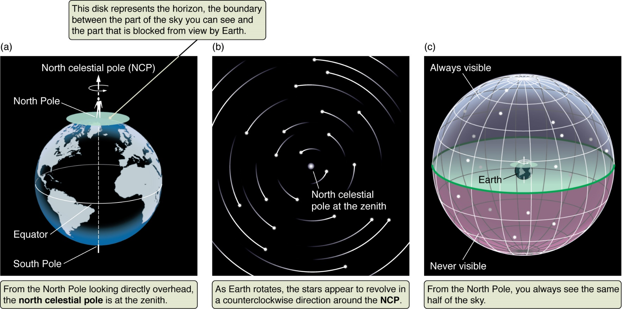
The Sky from the North Pole
Figure 2.8a

Slide 4
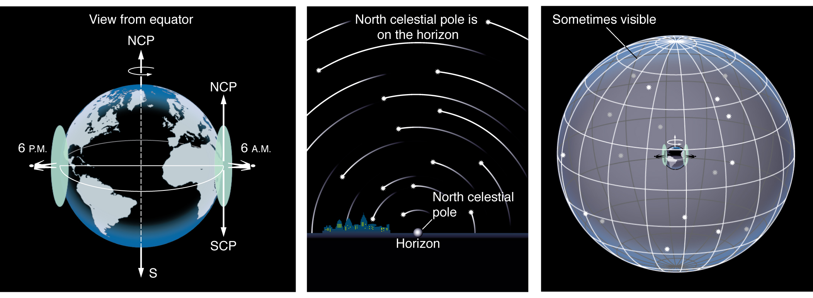
The Sky from the Equator
Figure 2.8c

Slide 5
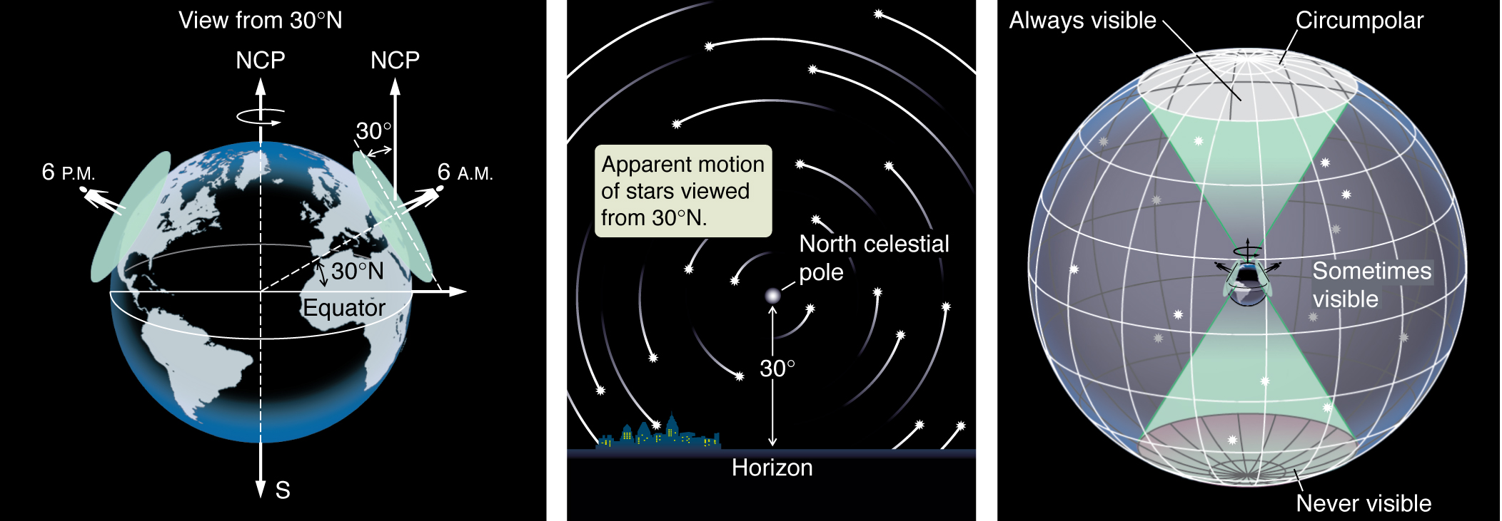
The Sky from 30 degrees North Latitude
Figure 2.8 b

Slide 6
What path would a star take if you observe it rising from 40° south latitude?
a) b) c)
50°
40°
50°

Slide 7
Consider these last two examples: the pattern made by stellar motions when viewed from different latitudes and the rising angles made with the horizon when viewed from different latitudes. Suppose Earth is stationary and the stellar motions are caused by the rotation of the Celestial Sphere containing the stars and the Sun. Will these two examples look the same in this case as they do when caused by Earth’s rotation?
Neither will look the same.
Stellar motions will look the same; rising angles will not.
Rising angles will look the same; stellar motions will not.
Both will look the same.

Slide 8
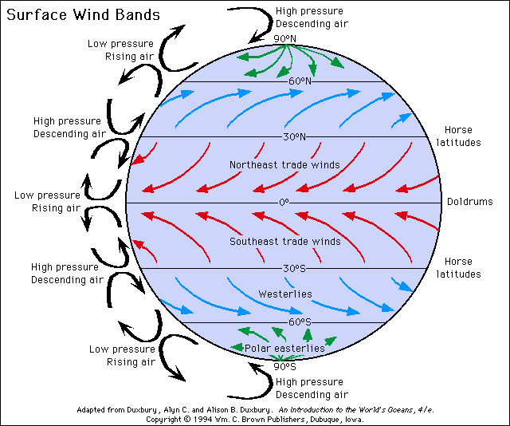

Slide 9
If you were to stand on Earth’s equator and throw a ball due east, the Coriolis Effect would result in
a northward deflection.
a southward deflection.
no deflection at all.
4) a westward deflection, i.e. the ball would slow down.

Slide 10
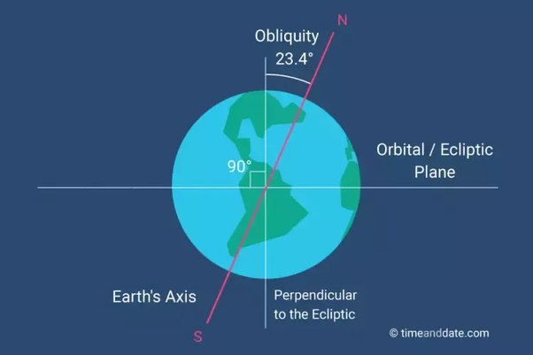
The Ecliptic

Slide 11
What is the primary cause of Earth’s seasons?
The orbit of Earth is an ellipse, so Earth is not always the same distance from the Sun.
Earth’s rotation axis tilts with respect to the plane of its orbit around the Sun.
Earth’s rotation axis precesses (wobbles).
In accord with Kepler’s Second Law, Earth moves faster during parts of its orbit around the Sun and more slowly during other parts.

Slide 12
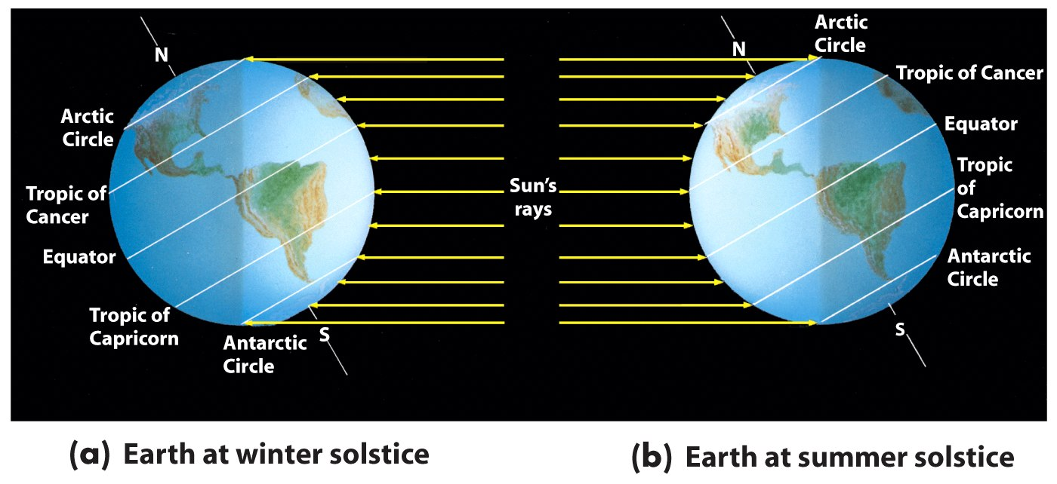
Tropics and Circles

Slide 13
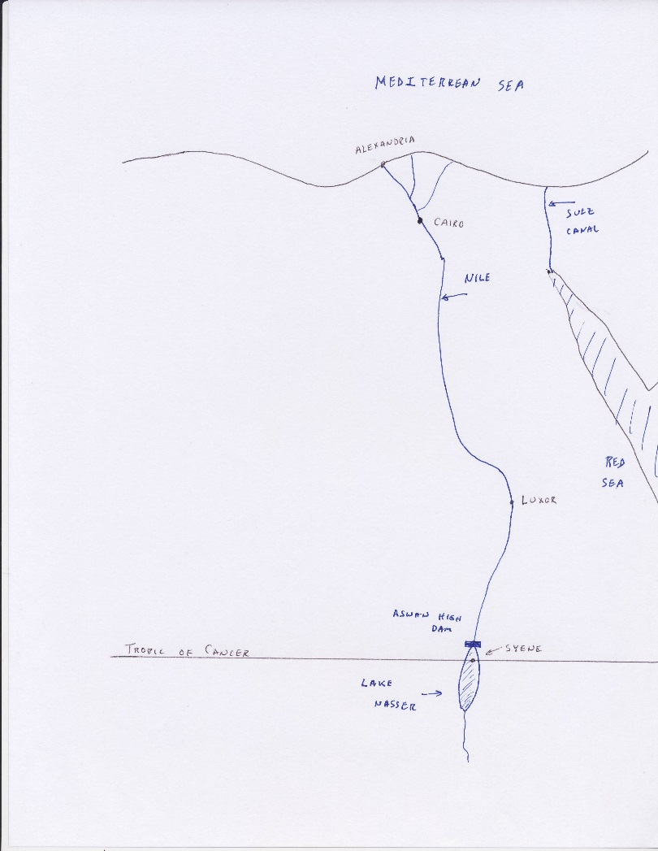

Slide 14
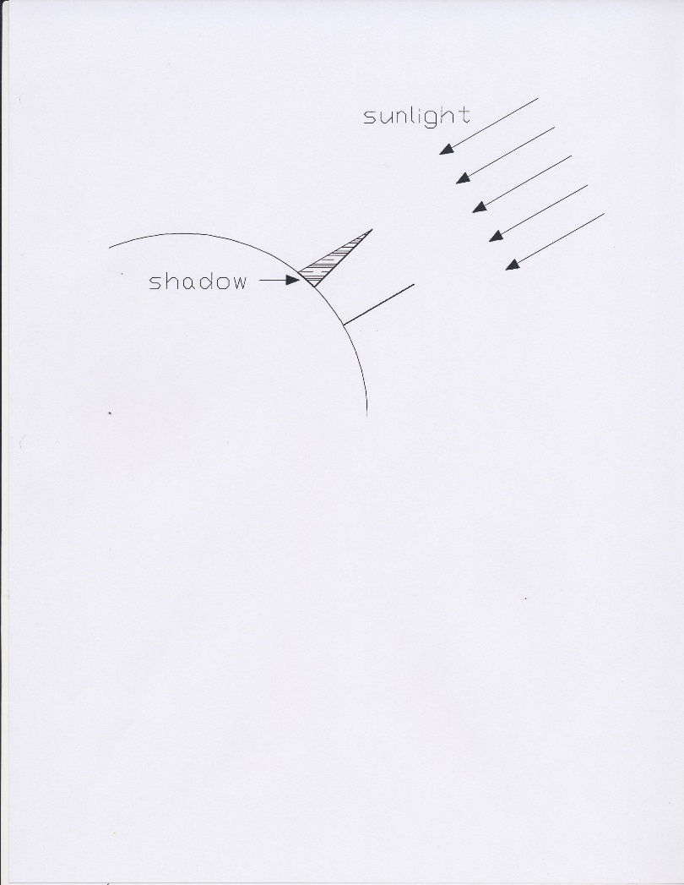

Slide 15
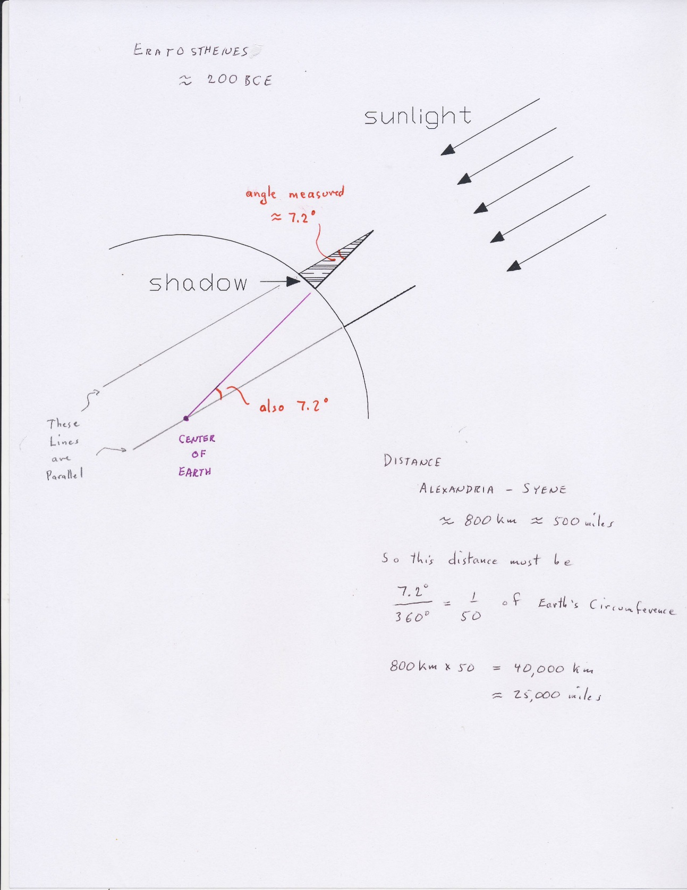

Slide 16
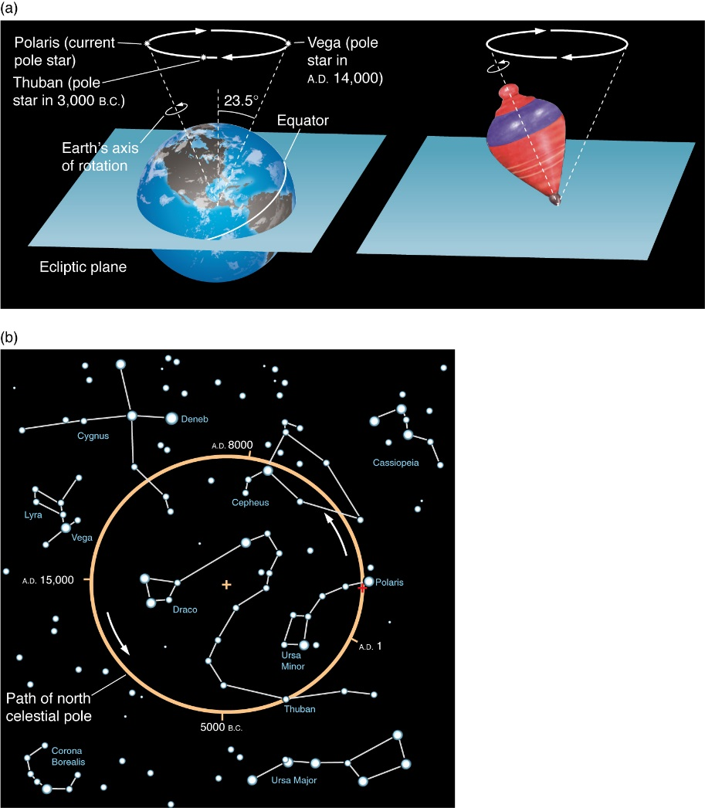
Figure 2.18a

Slide 17
Figure 2.18b

Slide 18
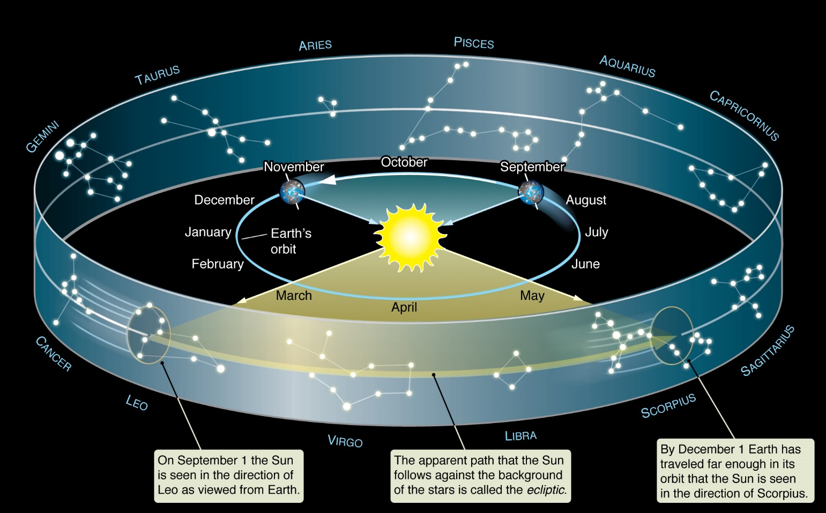
Figure 2.13

Slide 19
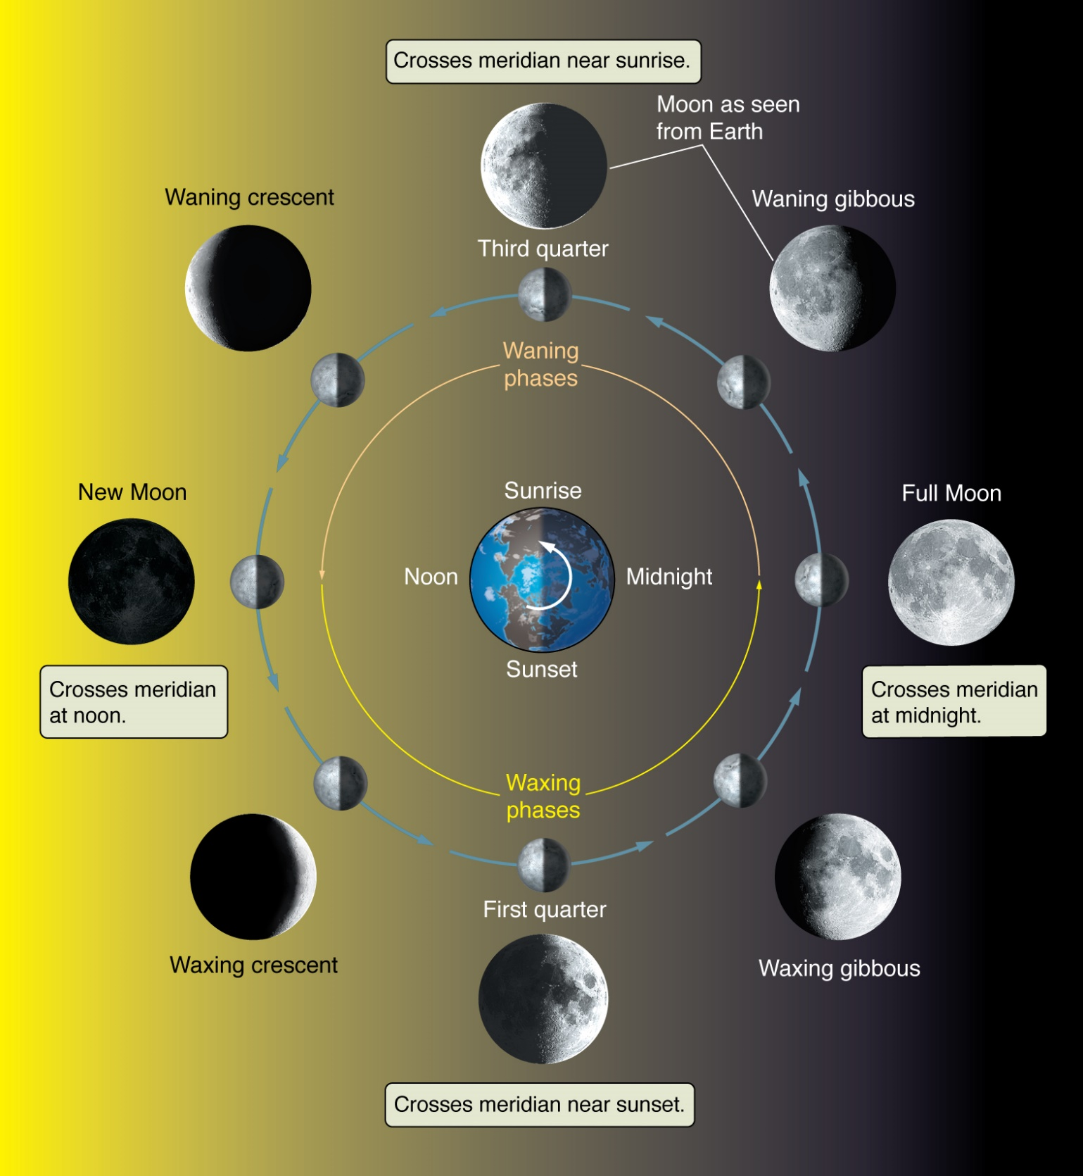
Moon Phases
Figure
2.20

Slide 20
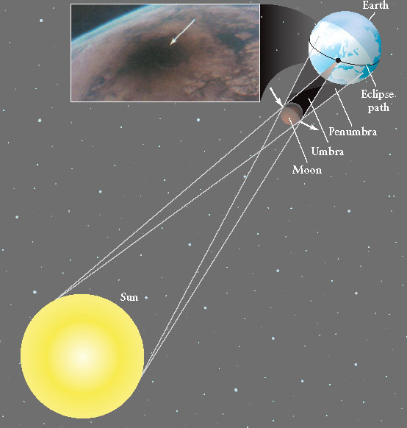
Geometry of a Solar Eclipse Freedman Universe

Slide 21
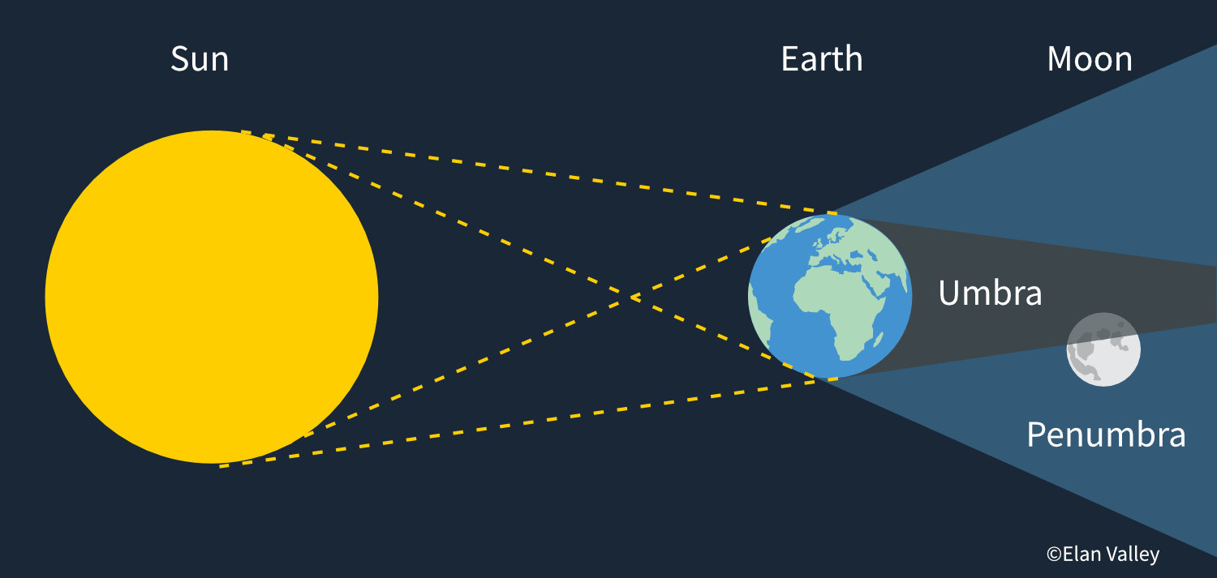
Lunar Eclipse

Slide 22
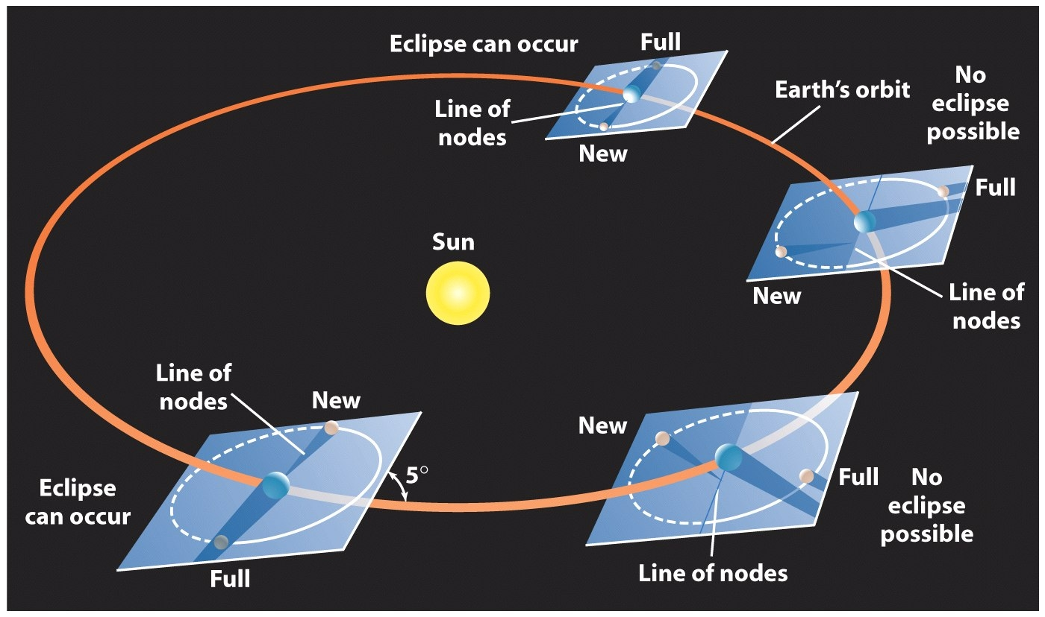
Conditions for Eclipses Freedman Universe

Slide 23
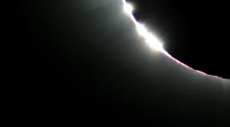
Baily’s Beads During a Total Solar Eclipse

